Slide 1
Determining Retail Categories to Open in the Church Hill Neighborhood of Richmond, VA
Mitch Phillips
1/21

Slide 2
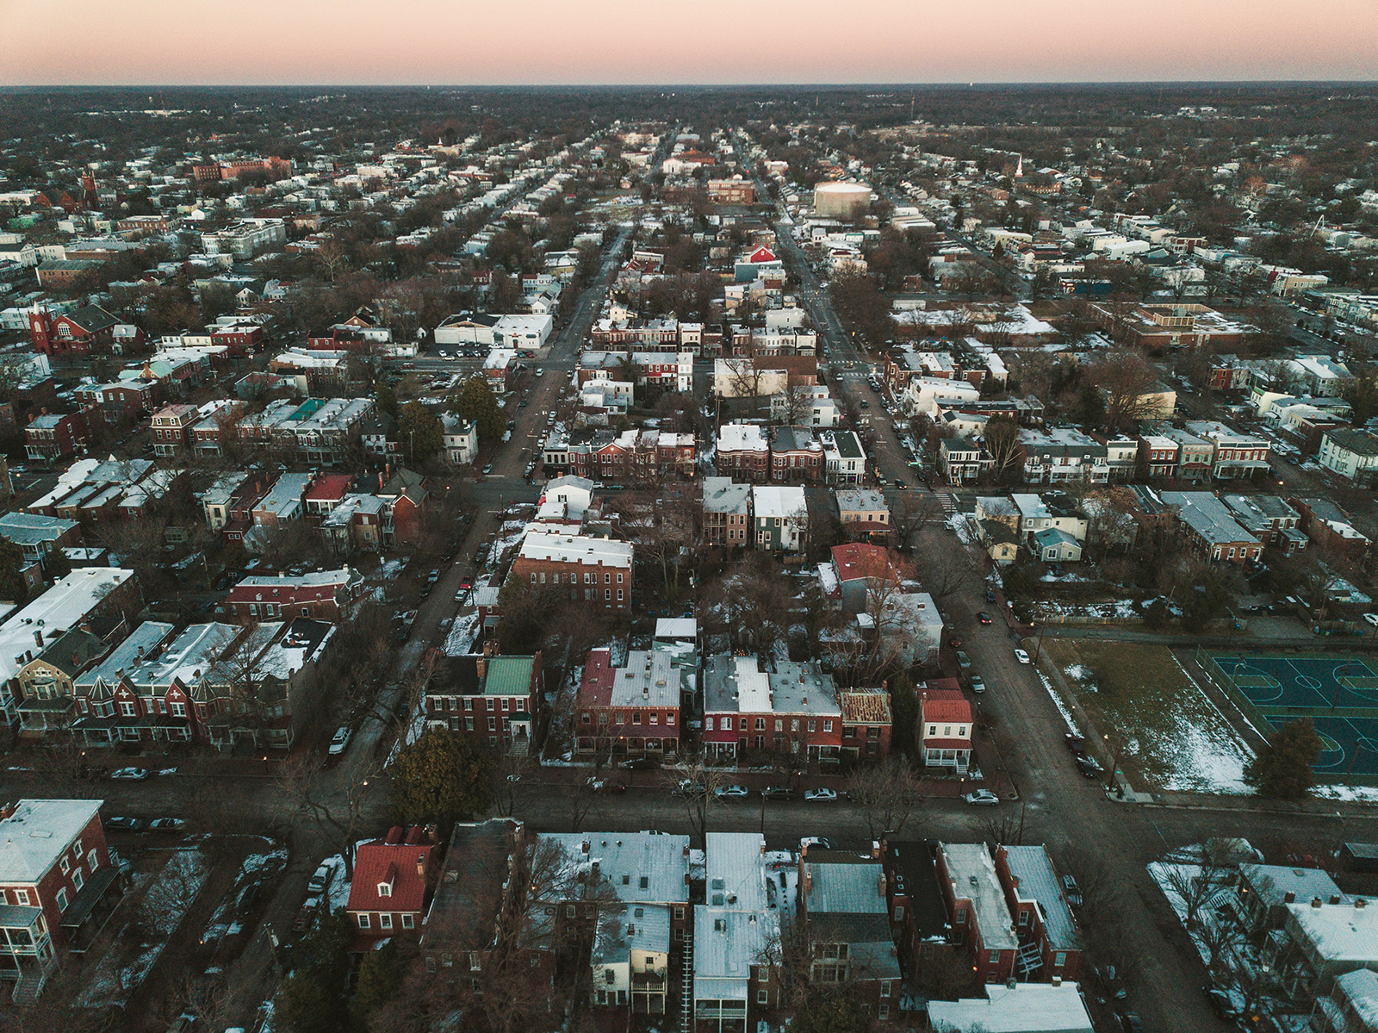
Introduction - Background
Goal: Determine under-represented retail categories with a high likelihood of success for a growing neighborhood.
For whom: Property managers, entrepreneurs, and existing retail business owners.
Where: Church Hill in Richmond, Virginia, a growing neighborhood.
How: Compare Church Hill retail to similar neighborhoods.
2/21

Slide 3
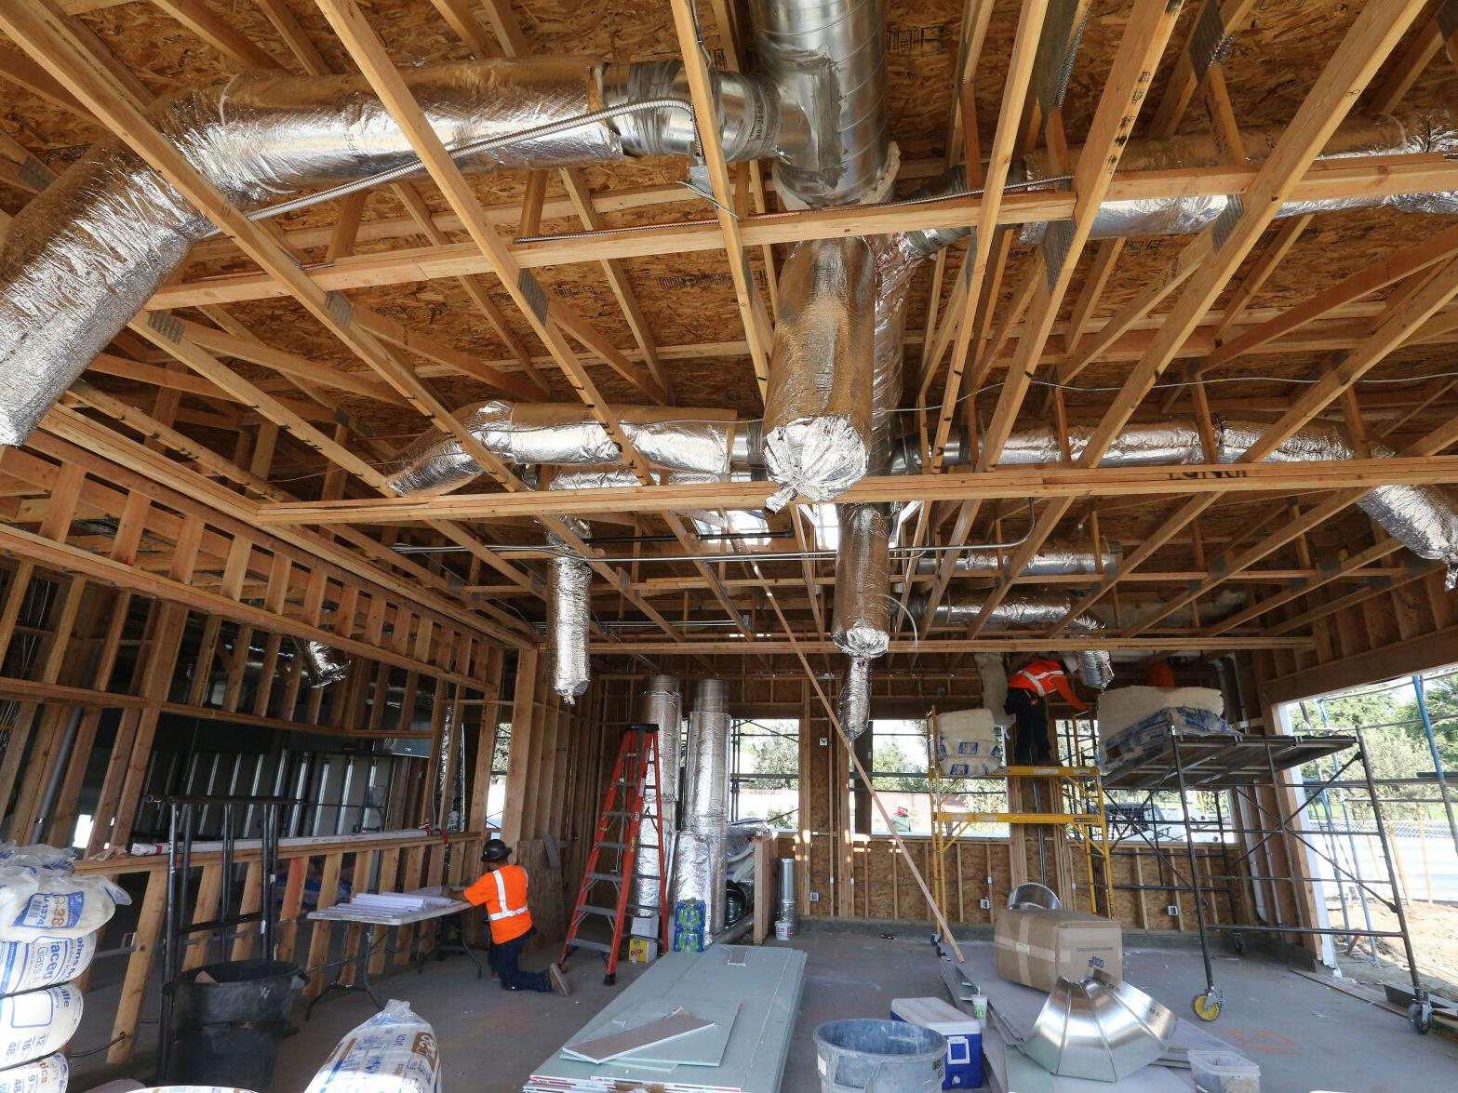
Introduction - Problem
How can we characterize the retail of Church Hill?
How can we determine neighborhoods similar to Church Hill?
How will we compare Church Hill to these similar neighborhoods?
3/21

Slide 4
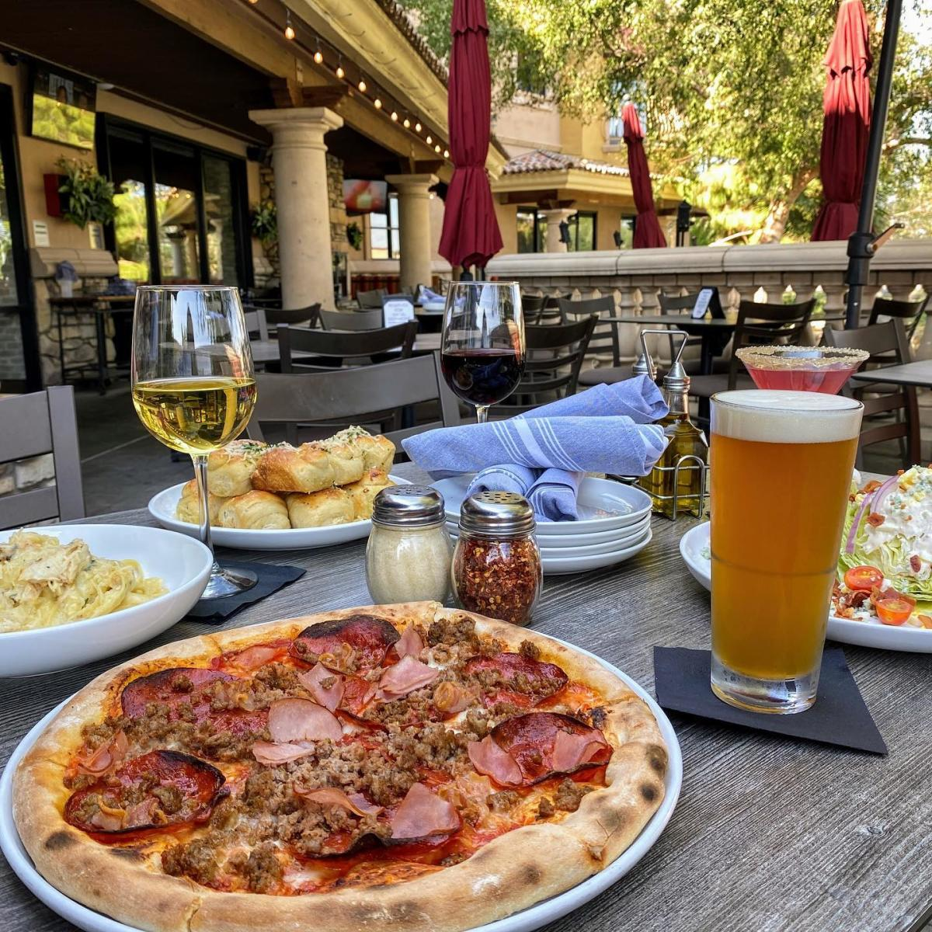
Introduction - Plan
Compile a list of retail categories present in many neighborhoods.
Machine Learning clustering to find neighborhoods similar to Church Hill.
Compare Church Hill retail categories to average frequency of retail categories in the cluster.
4/21

Slide 5
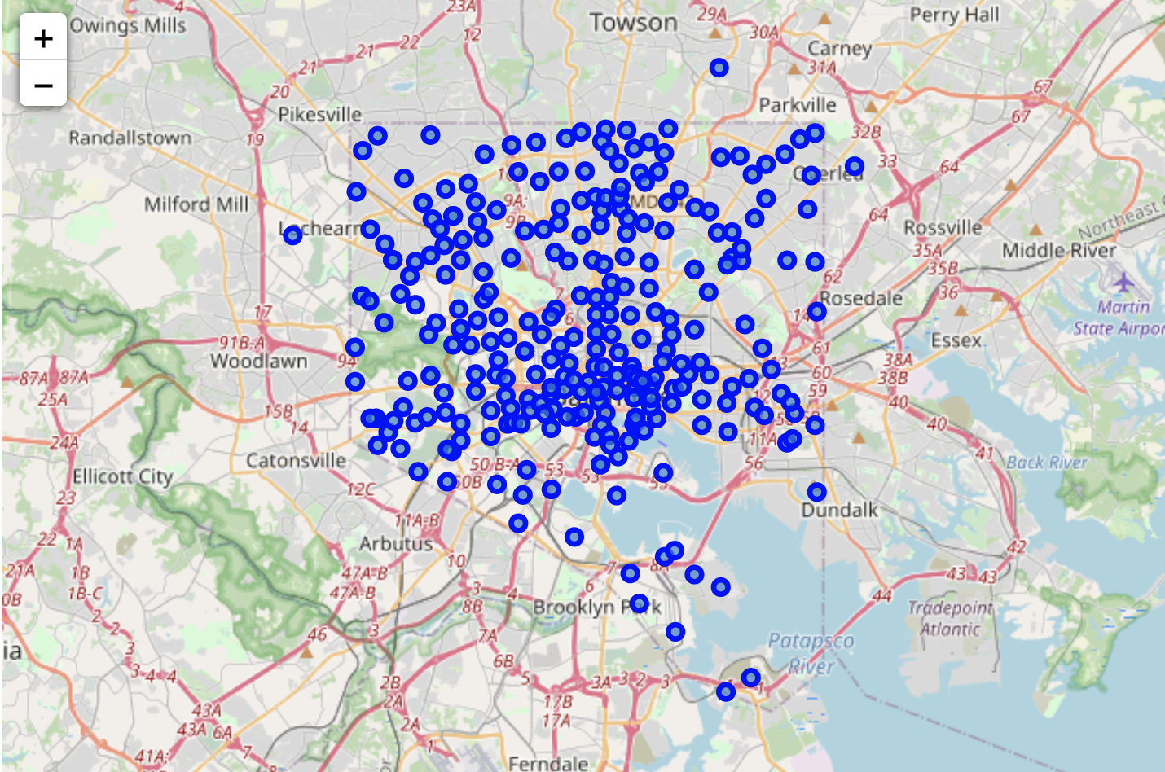
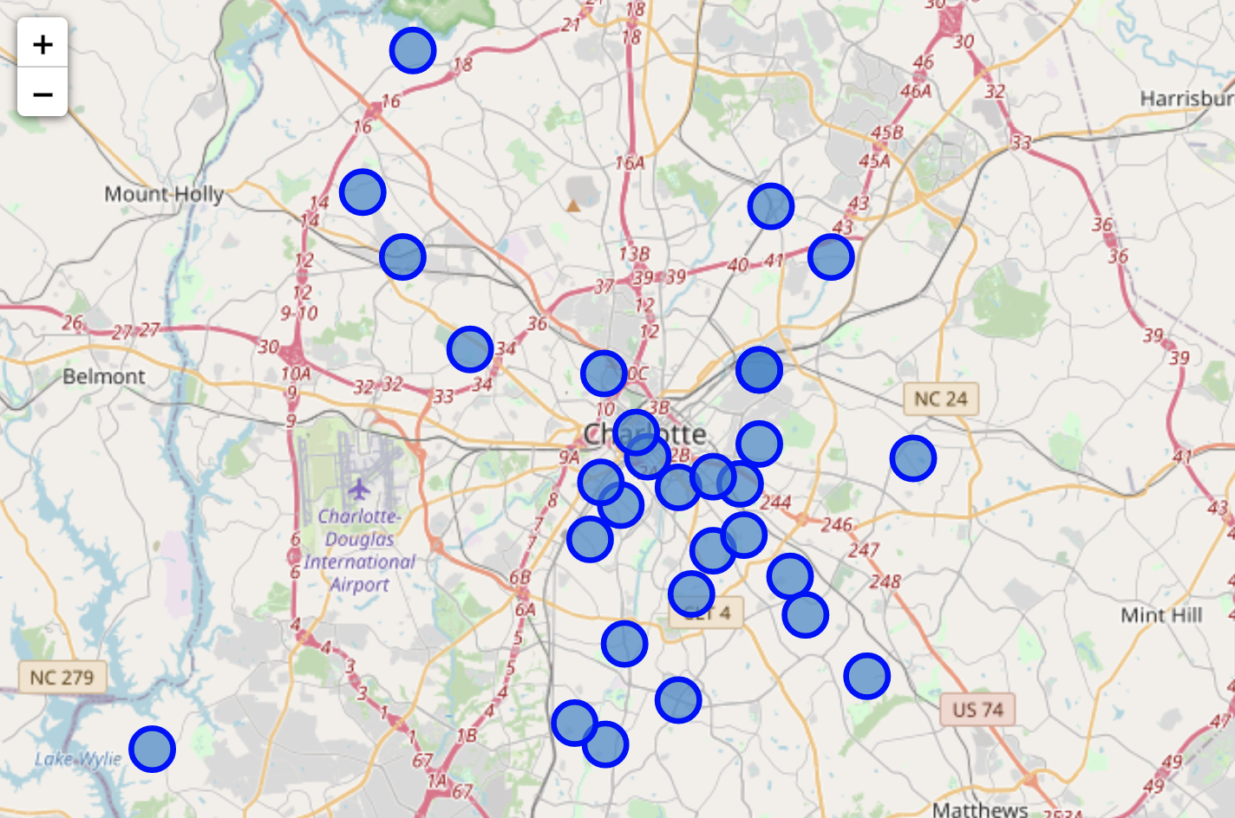
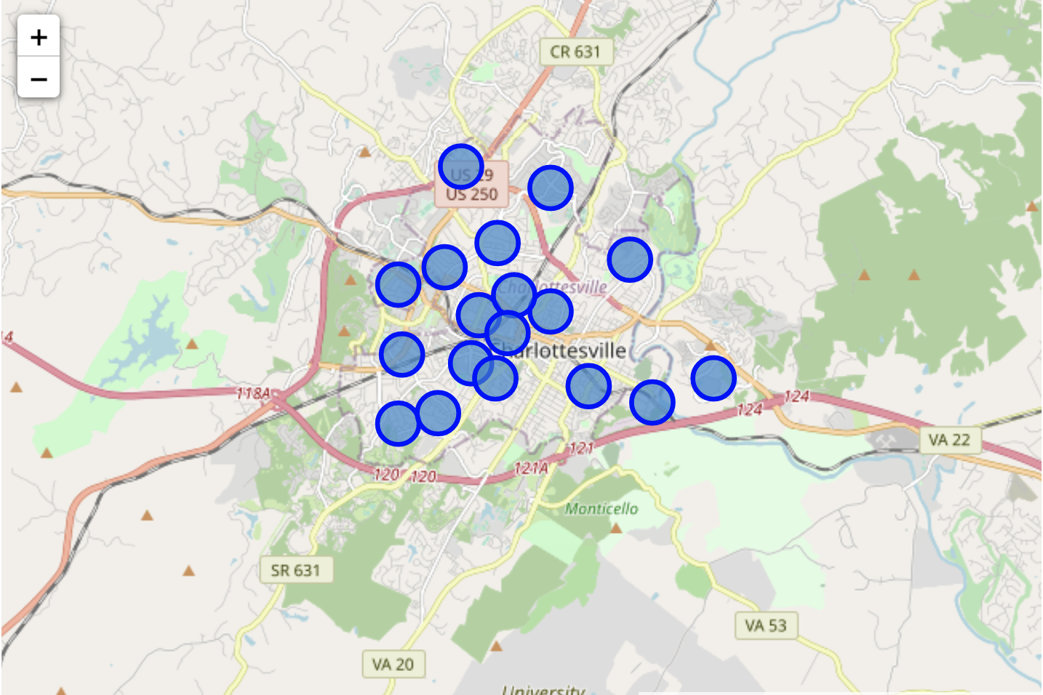
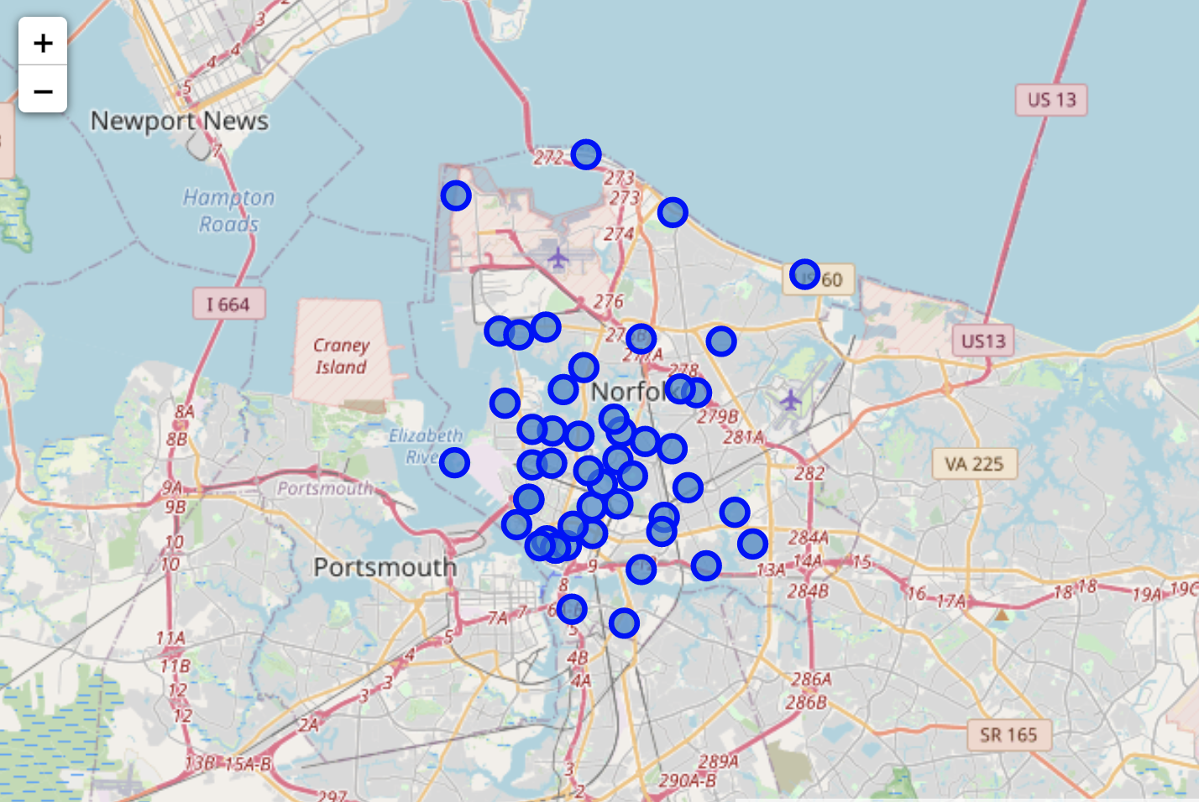
Neighborhood Data Collection
Baltimore, MD
Charlotte, NC
Charlottesville, VA
Norfolk, VA
5/21

Slide 6
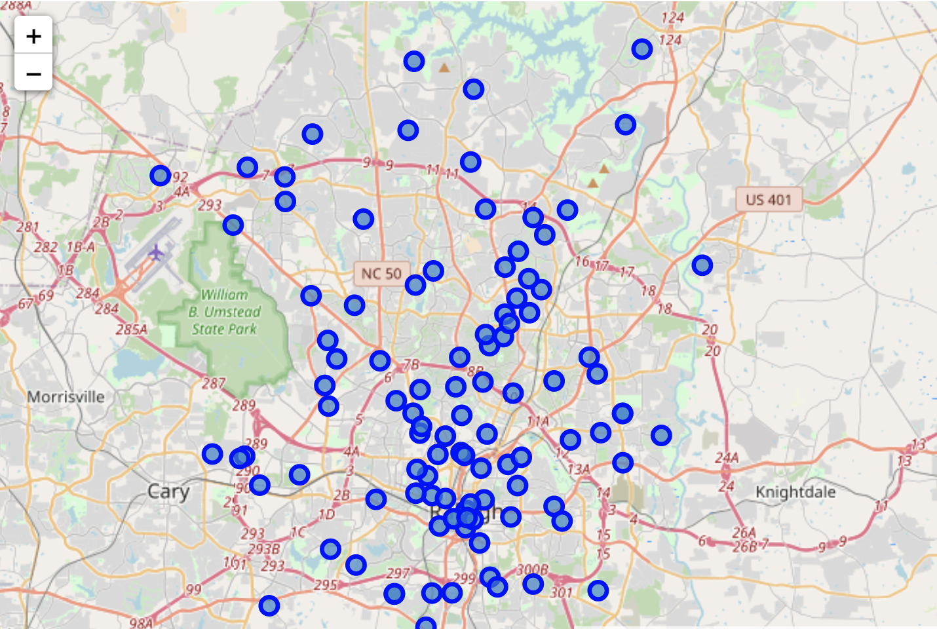
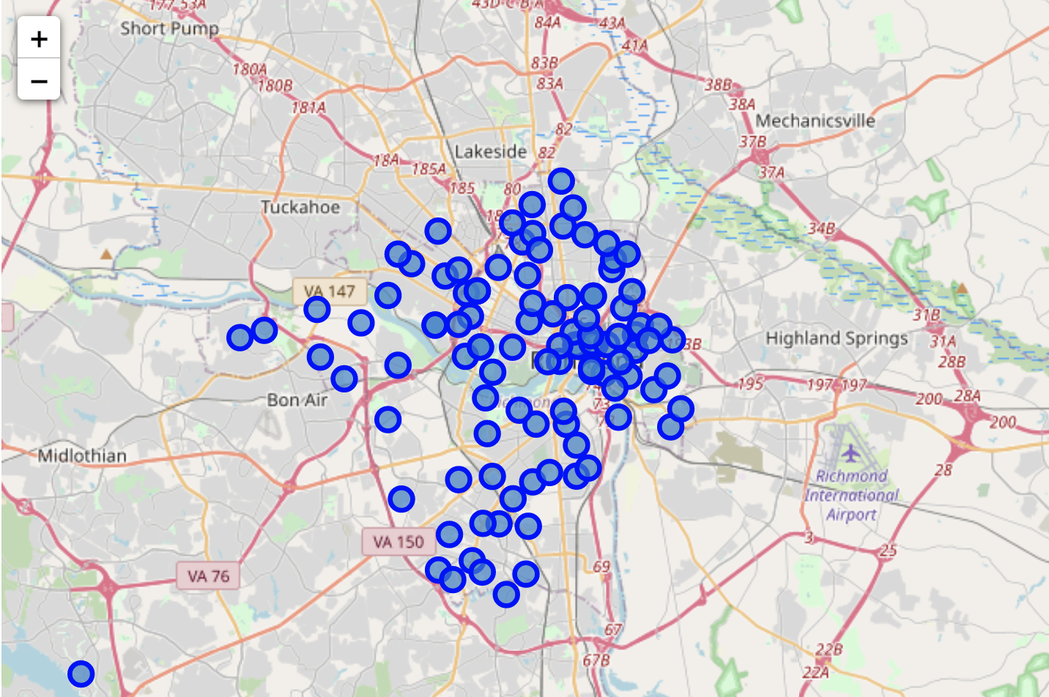
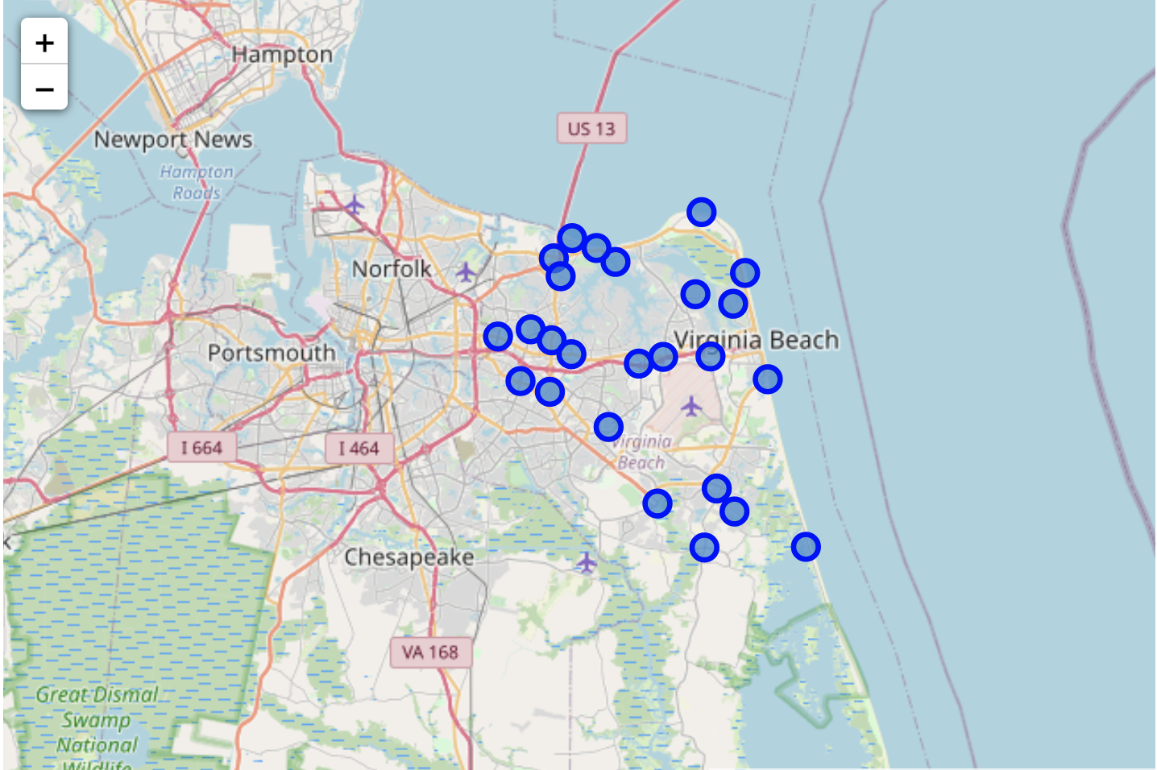
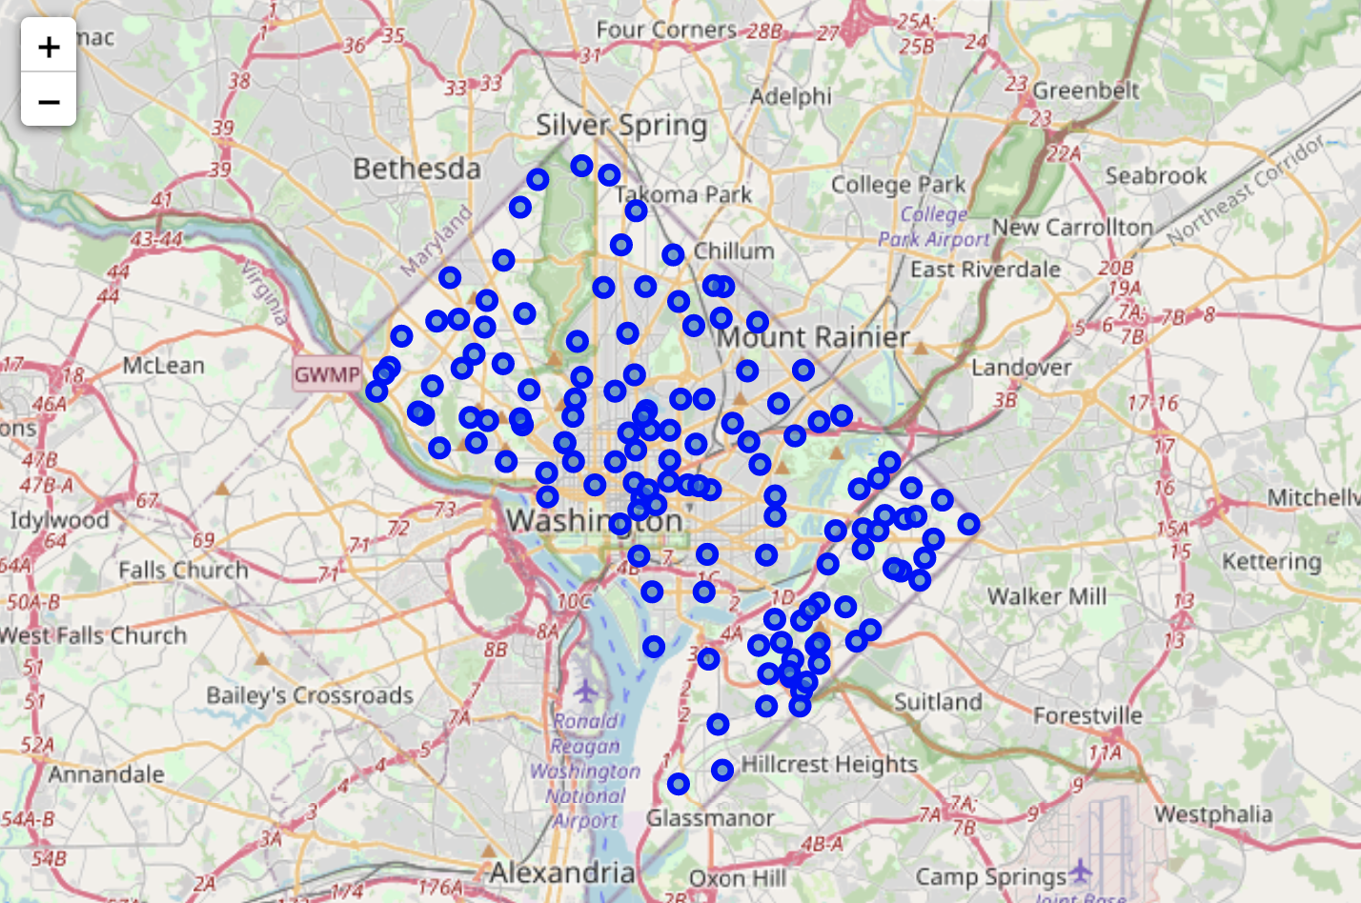
Neighborhood Data Collection
Raleigh, NC
Richmond, VA
Virginia Beach, VA
Washington, DC
6/21

Slide 7
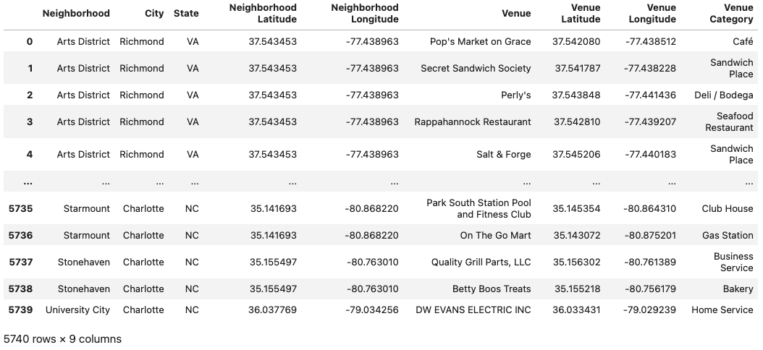
Foursquare Retail Venue Data
We've collected data on a total of 5740 retail venues from the eight cities and 747 neighborhoods.
7/21

Slide 8
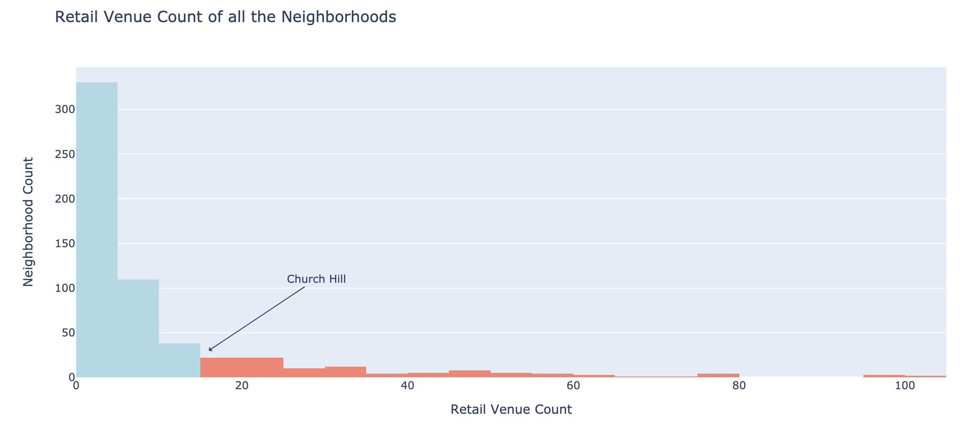
Data Cleaning – Removing Small Neighborhoods
First we get rid of unwanted Foursquare venue entries.
Then we remove entire neighborhoods with less than 15 retail venues.
Now we have 106 neighborhoods to cluster.
8/21

Slide 9
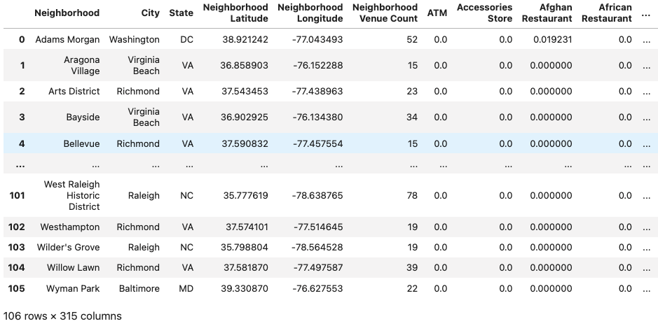
Data Preparation – Category Frequencies
We create a dummy column for each retail category and place a 1 in the corresponding venue row.
We group each neighborhood together and take the mean of the columns for a category frequency value.
There are 309 retail categories represented by dummy columns.
9/21

Slide 10
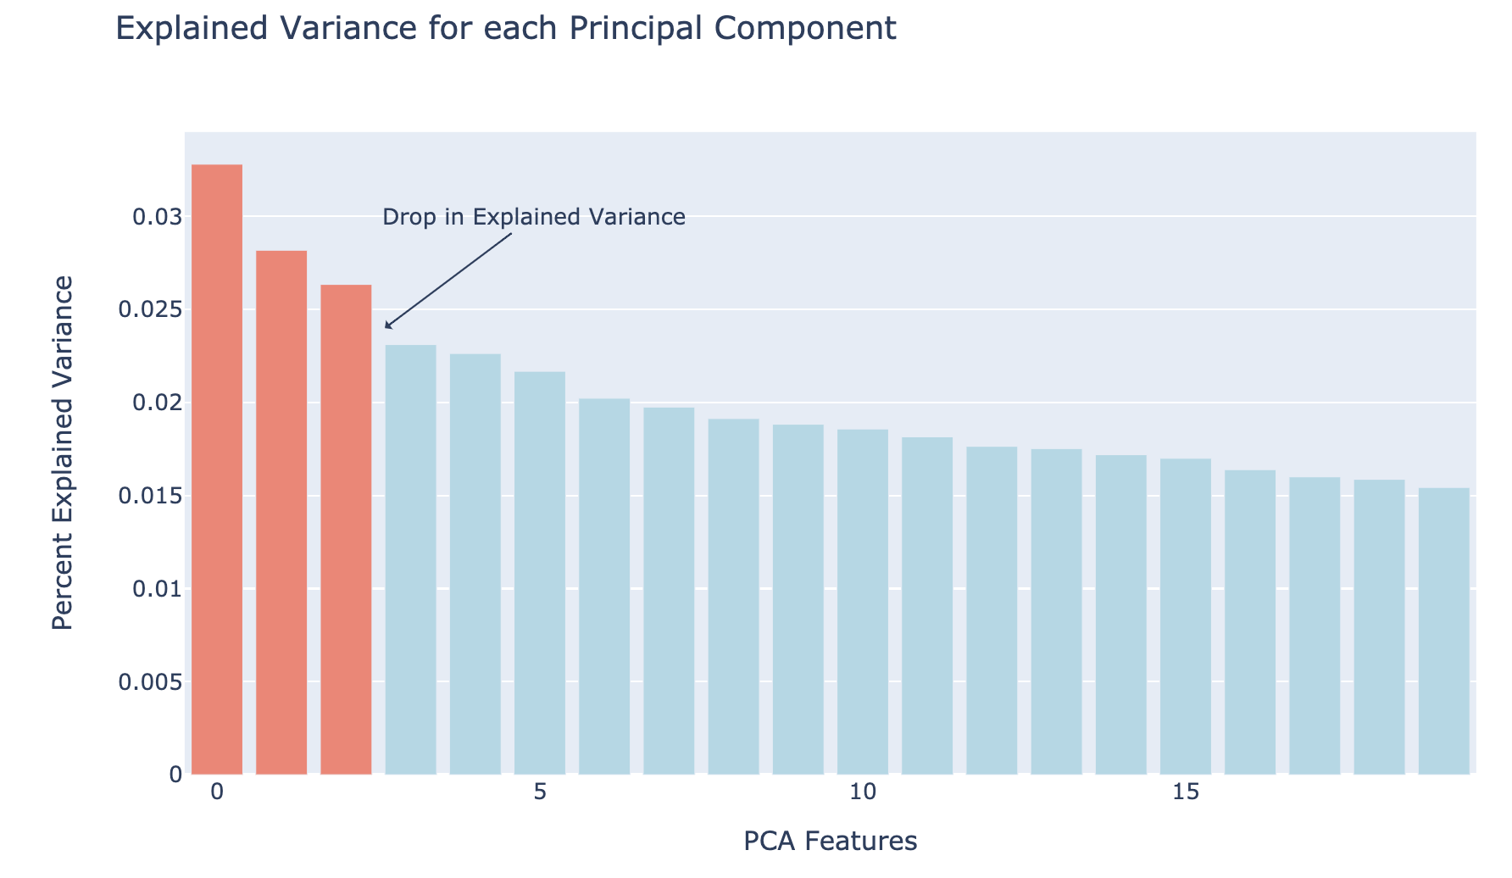
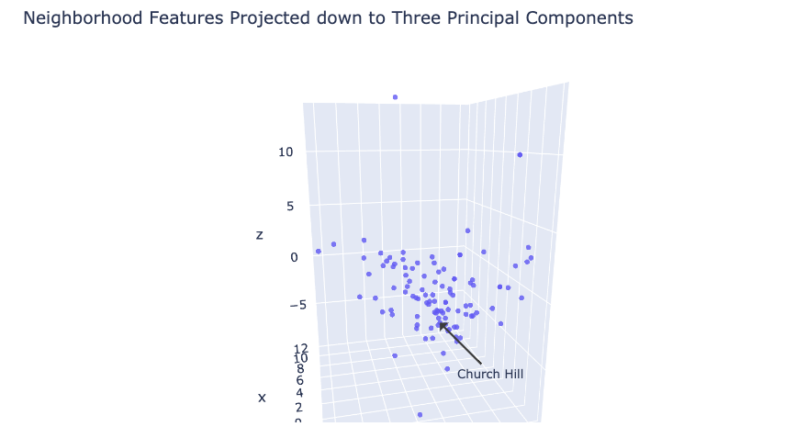
Data Preparation – PCA Dimensionality Reduction
Address data sparsity with principle component analysis.
Project the 310-dim data down to lower dimensions.
Choose 3 dimensions based on explained variance plot.
Plot the first three principle components to visualize the spread of the 106 neighborhoods before clustering.
10/21

Slide 11
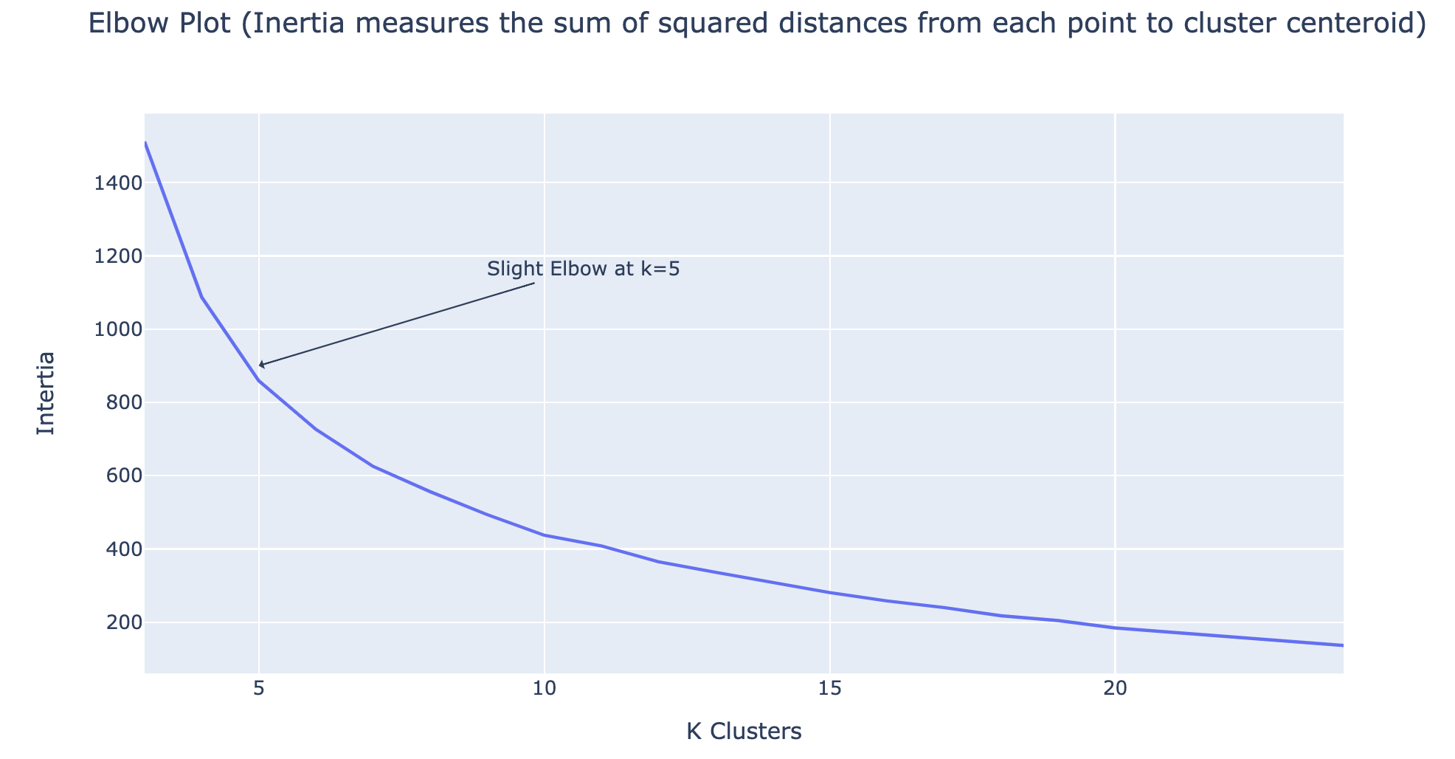
Training the K-Means Model
Choose K-Means clustering for efficiency and control over number of clusters.
Choose k=5 clusters based on inertia measurements in elbow plot.
11/21

Slide 12
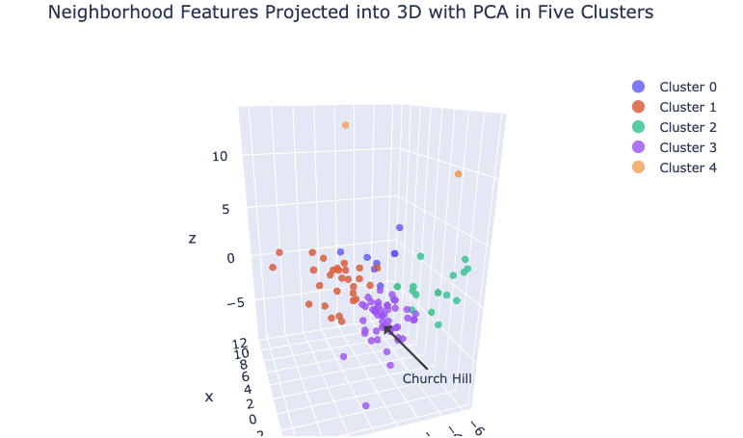
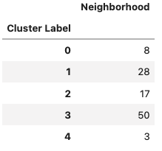
K-Means Clustering Results
Church Hill gets assigned to cluster 3 along with 50 other neighborhoods.
It is the largest and most central cluster in the 3D PCA plot.
12/21

Slide 13
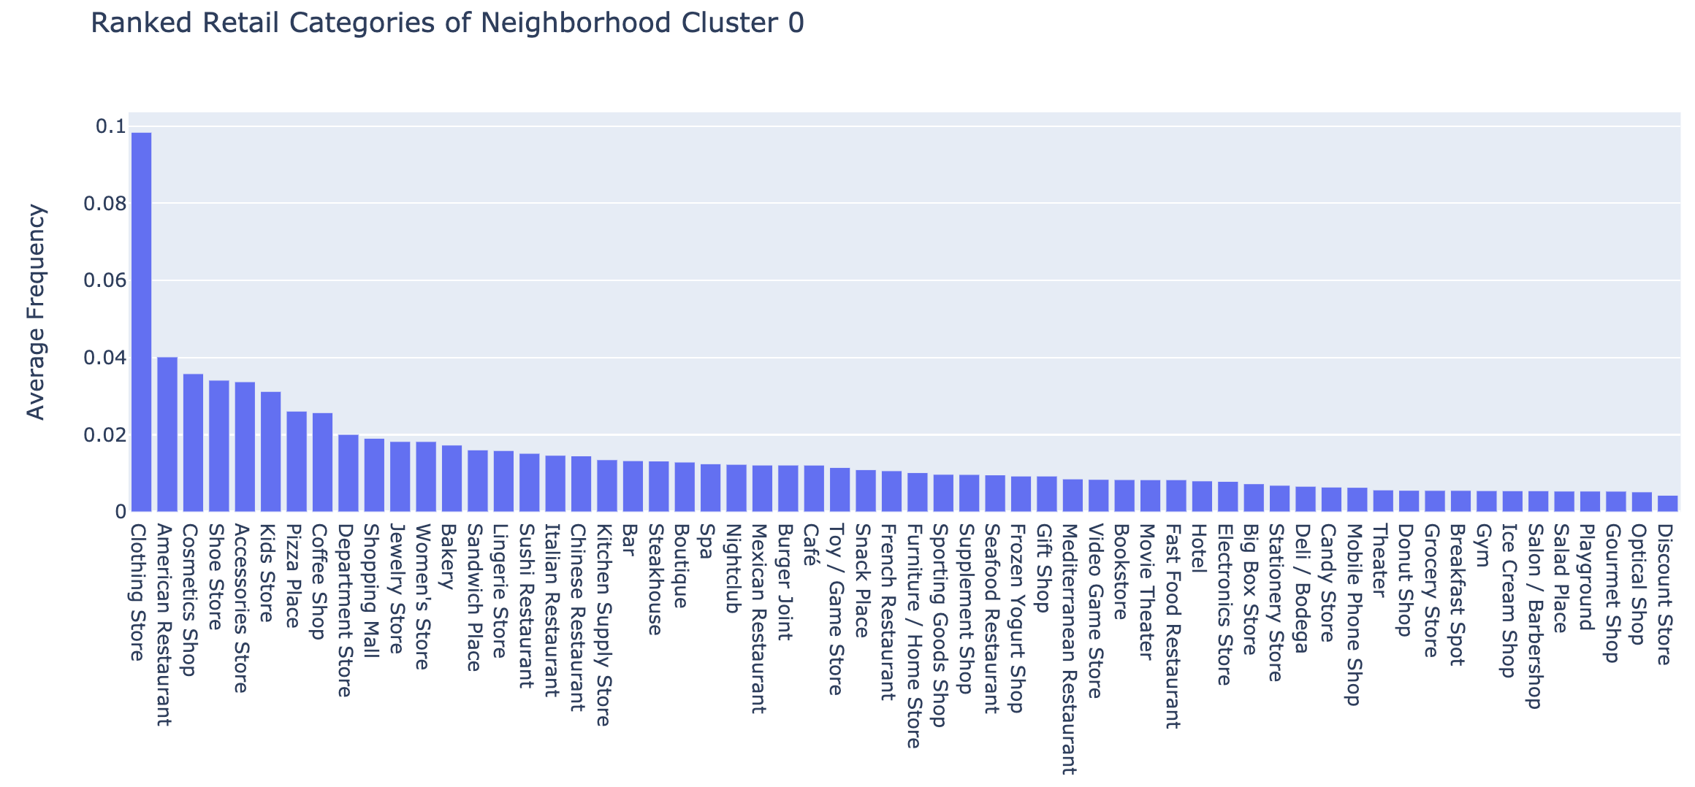
Analysis - Ranked Retail Categories of Cluster 0
13/21

Slide 14
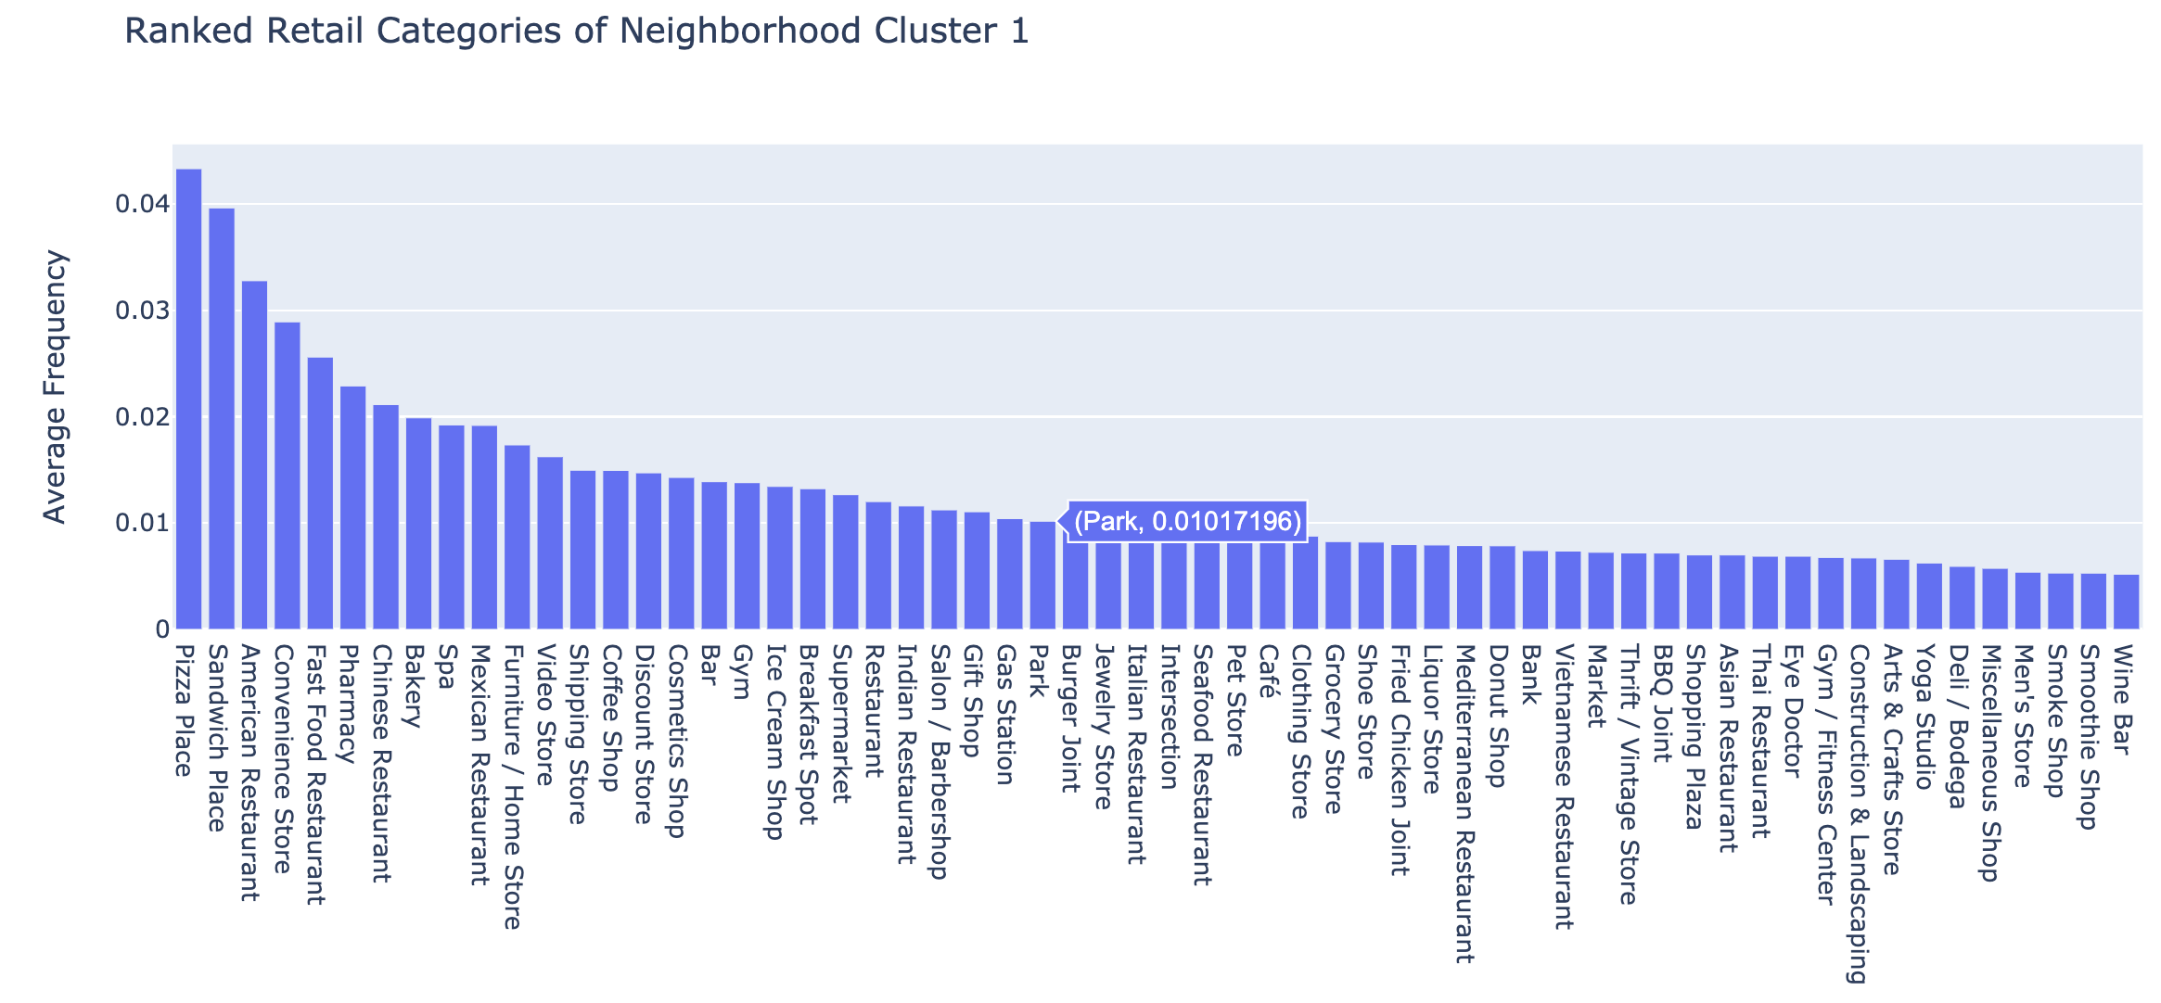
Analysis - Ranked Retail Categories of Cluster 1
14/21

Slide 15
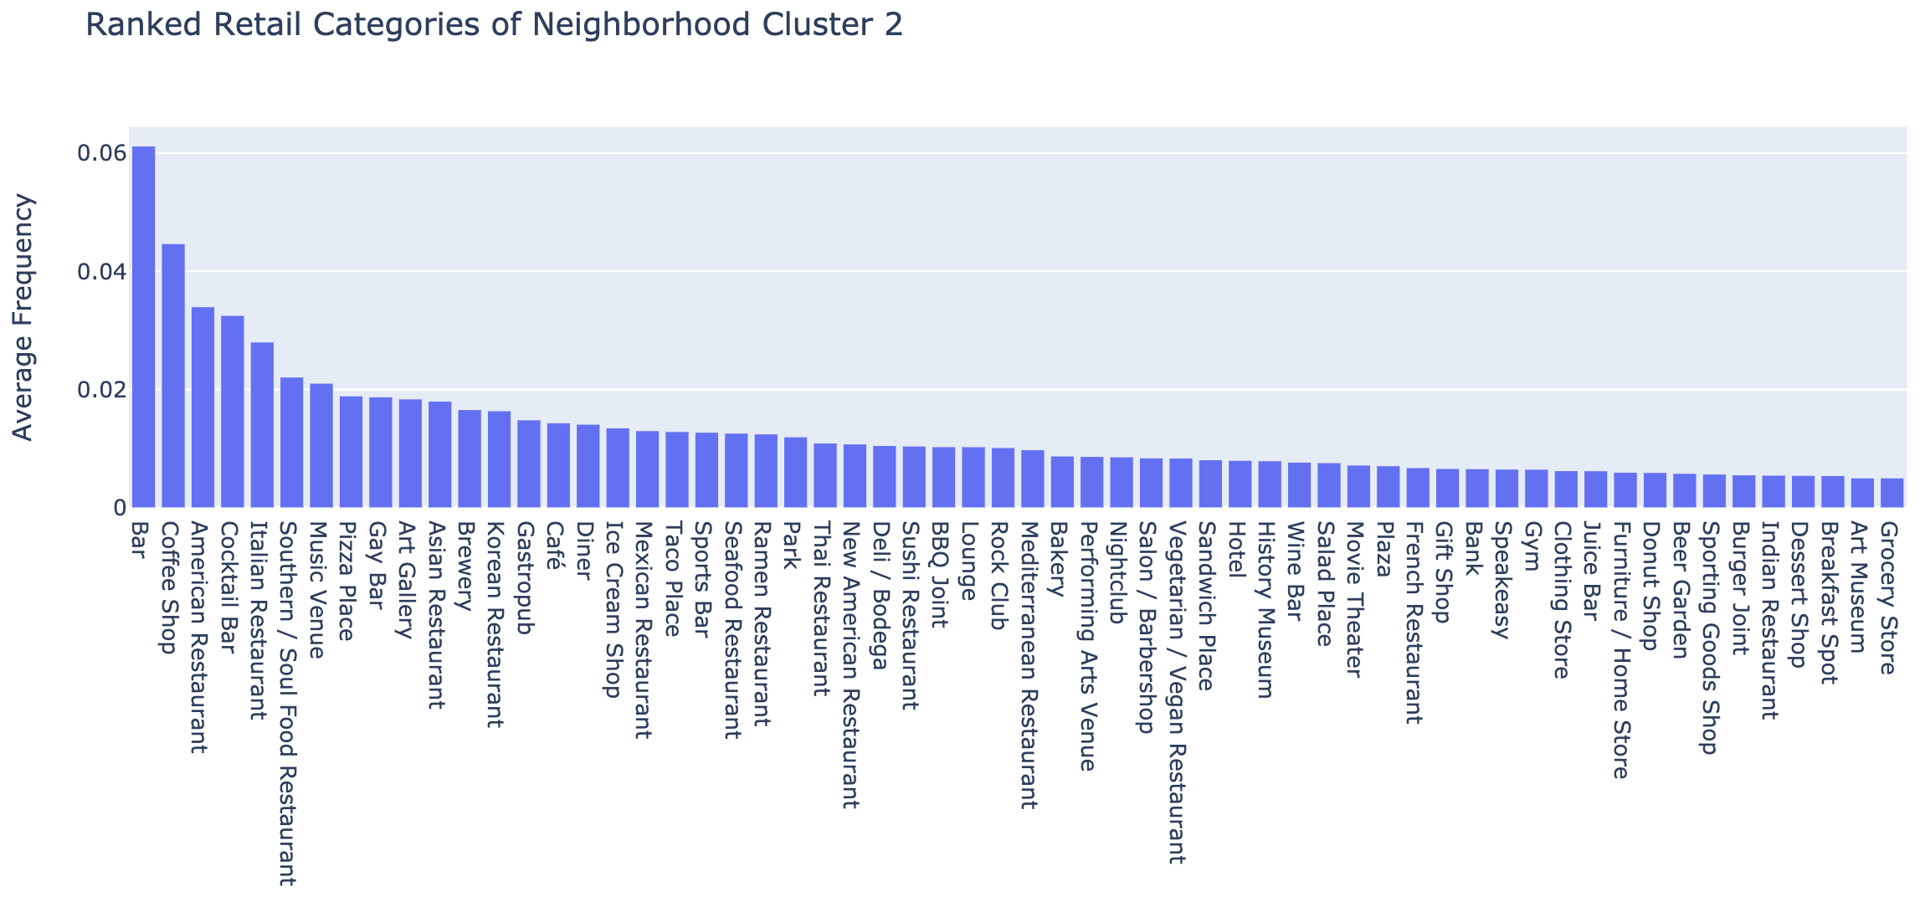
Analysis - Ranked Retail Categories of Cluster 2
15/21

Slide 16
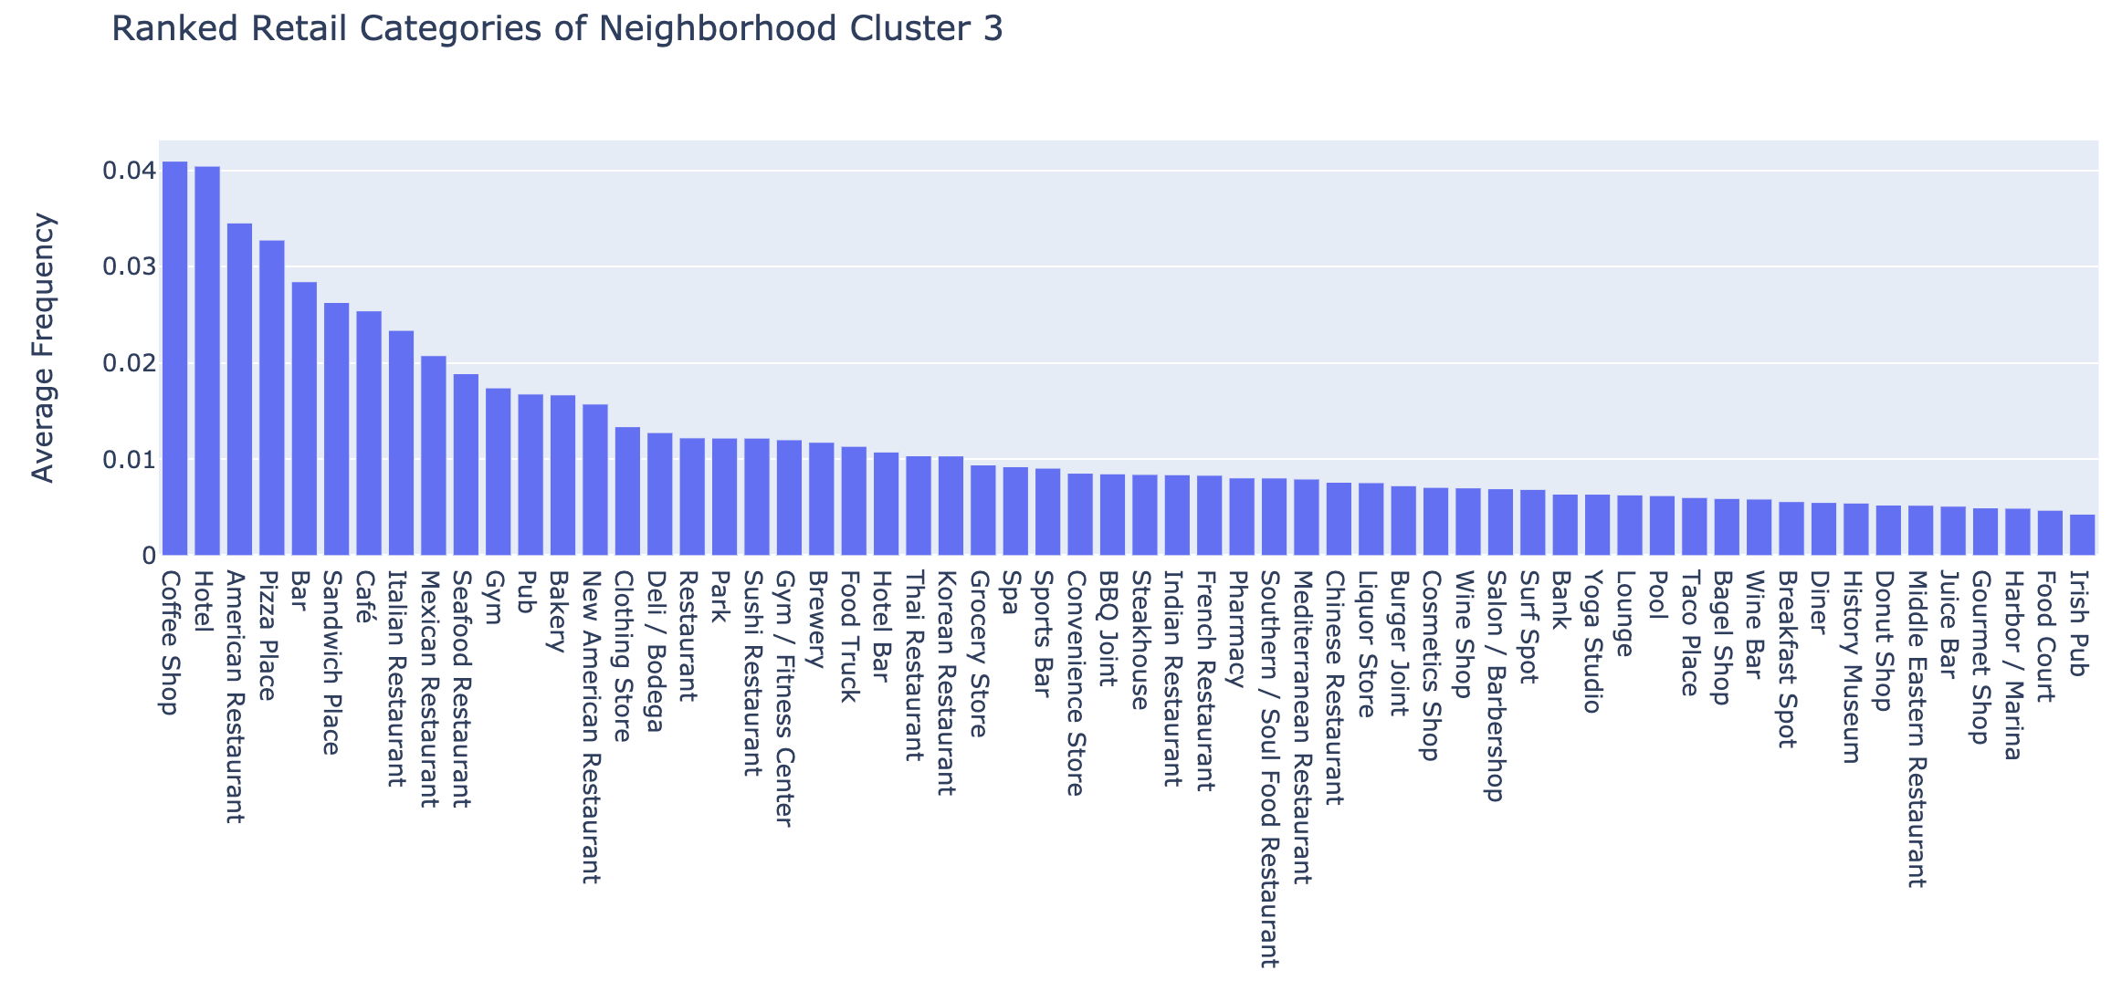
Analysis - Ranked Retail Categories of Cluster 3
Church Hill belongs to this cluster so we will come back to this plot.
16/21

Slide 17
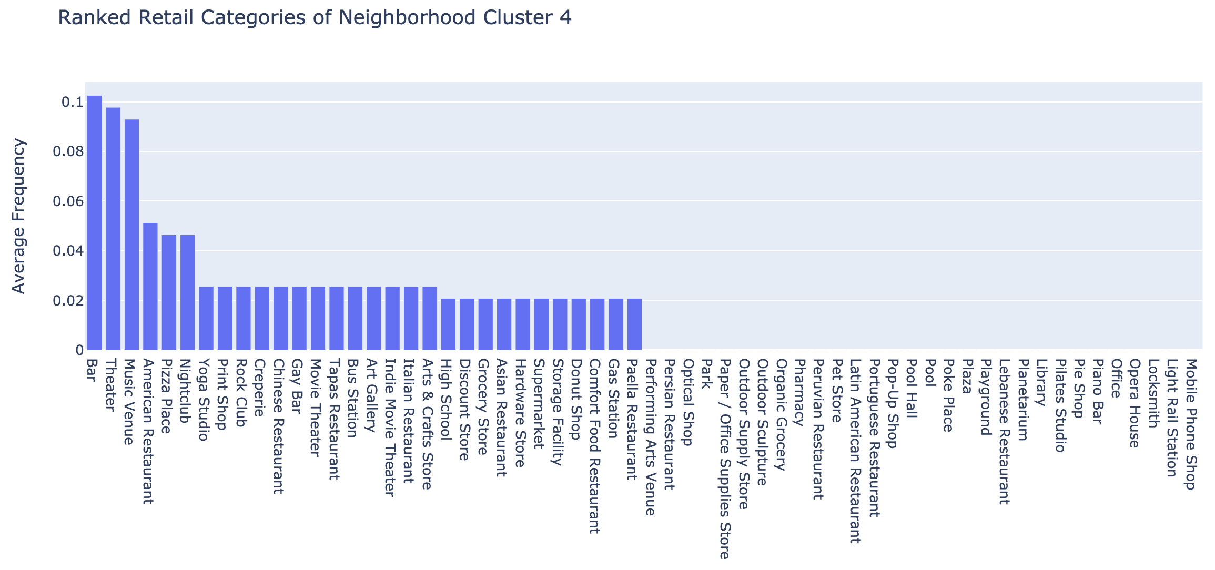
Analysis - Ranked Retail Categories of Cluster 4
17/21

Slide 18
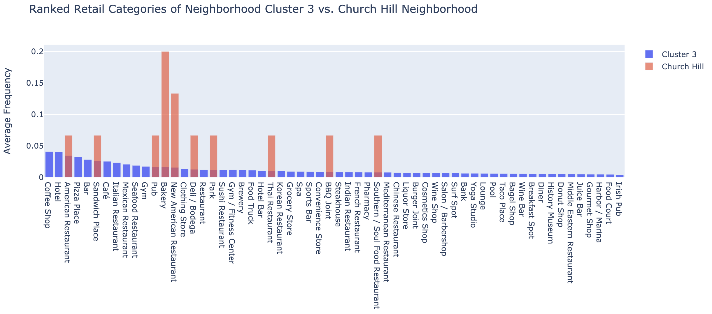
Analysis- Church Hill Compared to its Cluster
Categories in blue without red bars should open in Church Hill.
18/21

Slide 19
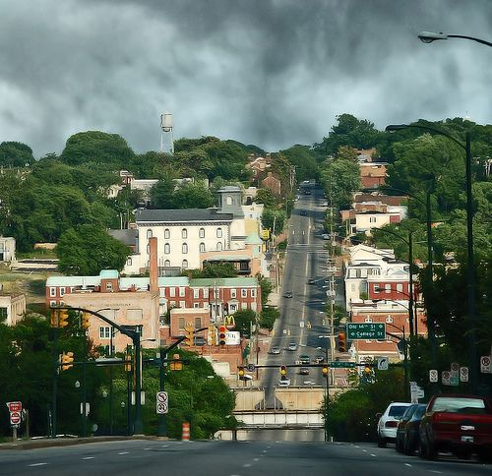
Conclusion - Results for Church Hill
Coffee shop
Hotel
Pizza place
Bar
Cafe
Italian Restaurant
Seafood Restaurant
Gym
Clothing store
Sushi restaurant
19/21

Slide 20
Conclusion – Validity of Results
Some retail venues seem to be missing from Foursquare.
Data sparsity made quality clustering difficult.
From personal experience with Church Hill I can say these results makes sense.
20/21

Slide 21
Conclusion – Further Work
Try other clustering algorithms such as DBSCAN or entropy-weighted K-Means.
Reduce data sparsity by:
… adding more neighborhoods,
… adding more data about the neighborhoods,
… adding more finely tuned retail subcategory information
21/21

